Slide 1
End-to-End Data Science using Watson Studio
April 30, 2020
The session starts at 9:00am.
Notes:
Cover slide. We’ll leave this up during Frank’s welcome.

Slide 2

End-to-End Data Science using IBM’s Watson Studio
Power of data. Simplicity of design. Speed of innovation.
Bernie Beekman
Michael Cronk
James Parry
Notes:
Welcome to ….
Be sure to document on the whitebioard the urls
for DSWB
for lab Notebooks ibm.box.xom/IntroApacheSpark Passsword = IBMSpark
for the POT Survey
Note the survey will revela the instructor notebooks upon completion.

Slide 3

Agenda
Time | Description
9:00 AM – 10:00 AM | Overview of Watson Studio Lab Orientation 1,2
10:00 AM – 10:15 AM | Break
10:15 AM – 11:45 PM | Lab 1-2 – Set up Environment, Watson Knowledge Catalog
11:45 PM 12:45 PM | Lab Review 1,2 /Lab Orientation 3,4 Lunch
12:45 PM – 02:00 PM | Lab 3,4 – Data Refinery, SPSS Modeler
02:00 PM – 02:30 PM | Lab Review 3,4 / Lab Orientation 5,6
02:30 PM – 03:30 PM | Lab 5,6 – Machine Learning with SparkML, AutoAI+DevOps
03:30 PM – 04: 00 PM | Lab Review 5,6 / Lab Orientation 7
04:00 PM – 05:00 PM | Lab 7 – Watson OpenScale

Slide 4
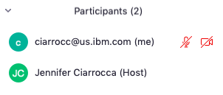
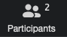
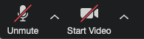
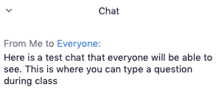
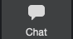

The Zoom Tool Bar
We will stay on mute during the main sessions. You may unmute yourself during breakouts.
We will not use video to preserve bandwidth during our class today.
The Share Screen function has been deactivated during the lectures
Notes:
This would go after the agenda chart – a quick review before we do the poll and start with the lecture.

Slide 5
Outline
Data Science Overview
Watson Studio Overview
Lab Overview

Slide 6
What is Data Science?
Domain Knowledge
Supply Chain
CRM
Financials
Networking
Domain Expertise
Engineering
Research
Data Science
Scripting, SQL
Python, R Scala
Data Pipelines
Big Data/ Apache Spark
Computer
Science
Math & Stats
Mathematics
Computational
Machine
Learning
Data Science Projects Require Multiple Skills
Modified from Drew Conway’s Venn Diagram
Notes:
Data science is the process of discovering hidden insights from massive amounts of structured and unstructured data, using analytical methods such as machine learning.
Data Scientist is the Unicorn combining knowledge of Computer Science, Math/Statistics, and having Domain Expertise.
Domain Expertise – to be effective as a data scientist the more you know and understand the domain the better. Allows you to communicate to SME to understand the modeling and Analysis requirements. Better understanding of the data elements. Etc.
Math+Stat – understanding the techniques available, their limitations where to apply them how to interpret results.
Computer Science – a lot of a capability is available out in open source. To capitalize on this you need to have programming expertise.
A data scientist is someone who is better at statistics than any software engineer and better at software engineering than any statistician .” ... Implicit in this definition is the focus on solving specific problems, in contrast with the type of deep understanding that is typical in academic statistics.

Slide 7
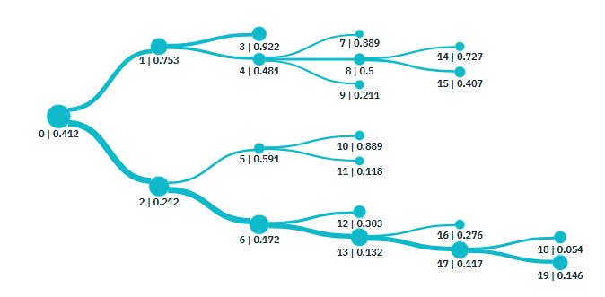
What is Machine Learning?
“Computers that learn without being explicitly programmed”
data
data
Training
data
1
A machine learning model is
trained to recognize
patterns in historical data
data
data
data
Historical
Data
+ Outcome
Trained model
Algorithm
data
data
data
prediction
or
classification
2
The model is then shown
new data and asked to predict or classify it. If the patterns
In the new data match the
training data then the model
makes accurate predictions.
data
data
data
New
Data
Trained model
Notes:
Supervised Machine Learning
Future behaves like the past.
Data + Code = Outcome
Data + Outcome = Code

Slide 8
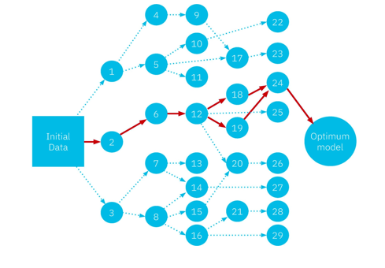
What is Deep Learning?
“Computers that learn without being explicitly programmed”
data
data
Training
data
1
A machine learning model is
trained to recognize
patterns in historical data
data
data
data
Historical
Data
+ Outcome
Trained model
Neural
Network
data
data
data
prediction
or
classification
2
The model is then shown
new data and asked to predict or classify it. If the patterns
In the new data match the
training data then the model
makes accurate predictions.
data
data
data
New
Data
Trained model
Notes:
Algorithm is a deep neural network → Deep Learning

Slide 9
IBM takes an Enterprise Approach to Data Science
Freedom of Choice
Choose programming languages, open source libraries, IBM value-add capabilities
Code/Click
Machine Learning/Deep Learning/Decision Optimization.
All Data
Operationalize Machine Learning
Manage complete ML lifecycle – Build, Deploy, Manage, Scale, Monitor, Re-train
Hybrid ML
Build where you want, deploy where you want
Governance
Ensure that right people get access to the right data
Notes:
Coders – R, Python, Clickers – visual programming
Novice users versus Advanced Users
All types of analytics – including optimization.
Operationalize Machine Learning – incorporate machine learning into the business frabic by operationalizing the results.
Hybrid – train in cloud, deploy on-prem
Train on private cloud – deploy on public cloud

Slide 10
Outline
Data Science Overview
Watson Studio Overview
Lab Overview

Slide 11





IBM Watson Studio Platform
Drive governance policy effectiveness while tracking how data is used and its value to the company
Data Steward
Make the insights immediately actionable and add intelligence to apps in straightforward manner
App Developer
An integrated platform of tools, services, data, and metadata that help companies or agencies accelerate their shift to be data-driven organizations.
Data Engineer
Easily build data pipelines that power dashboards and data platforms while ensuring high quality
Business
Analyst
Build dashboards
and reports to visualize insights to the business
Data Scientist
Access powerful tools to tease out the insights using advanced analytics
Notes:
Watson Studio is an integrated platform of tools, services, data, and meta-data to help companies and agencies accelerate their shift to be data driven organizations. The platform enables data professionals such as data scientists, data engineers, business analysts, and application developers collaboratively work with data to build, train, deploy machine learning and deep learning models at scale to infuse AI into business to drive innovation. Watson Studio is THE IBM public cloud foundation designed to support the development and deployment of data and analytics assets for the enterprise.
Data and analytics vision of whole enterprises
Watson Studio accelerates the machine and deep learning workflows required to infuse AI into your business to drive innovation. It provides a suite of tools for data scientists, application developers and subject matter experts to collaboratively and easily work with data and use that data to build, train and deploy models at scale.
Watson data platform is THE IBM public cloud foundation designed to support the data and analytics vision of whole enterprises
Delivering a fully integrated platform that sustains both analytical investigations and putting insights into active use in production at any scale.
It delivers the user experiences that amplify the ability of every data professional to execute on that vision

Slide 12
Watson Studio Deployment Options
Watson Studio on IBM Cloud
Managed offering provided by IBM
Watson Studio Desktop
IBM Cloud Private for Data
Watson Studio Local
Notes:
Different Data Science Platform cloud deployment options

Slide 13






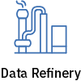














Watson Studio Tools
Build and train at scale
Authoring Tools
Using best of breed - Open source & IBM tools
Code (R, Python or Scala) and no-code/visual modeling tools
Decision Optimization
Visual
Recognition
Streams Designer
Auto AI
Machine Learning Runtimes
Deep Learning Runtimes
Container-based resource management
Elastic cpu/gpu power
Run on x86, Power, zLinux
Integrate with Hadoop/Spark Infrastructure
Scalable & modern infrastructure
Train and deploy where your data lives
IBM Cloud
Fully Managed
On-prem
IBM Cloud
Notes:
Create, collaborate, deploy, and monitor
Best of breed open source & IBM tools
Code (R, Python or Scala) and no-code/visual modeling tools
Open Source and IBM libraries/frameworks

Slide 14
Watson Studio supports the Data Science Lifecycle
Build, train, deploy, and monitor at scale ML/DL workflows to infuse AI into the enterprise to drive innovation.
Connect to Data
Find Governed Data
Save and Deploy
Build Model
Prepare Data
Monitor and Manage
Create Project
Research Topics
Notes:
Position these offerings in how they support the Data Science Project Lifecycle
Start with Creating a Project. The project is a core component of the IBM Data Science Platforms. It is a place where you can organize your resources to achieve a particular data analytics goal.
Research topics – may want to read an article about a technique. Go through a tutorial. Or start with an existing notebook.
Find data that is needed for your analysis.
Connect to data – or access the data
Data Understanding or Data Exploration and Preparation. -

Slide 15
Watson Studio Project Features
Create Project
Making Data Science a Team Sport
Organizes resources to achieve a particular data analysis goal
Support role-based collaboration (Admin, Editor, Viewer)
Assets from all IDEs can be included in one Watson Studio project: notebooks, data sources, flows, models, etc.
Export/Import Projects

Slide 16
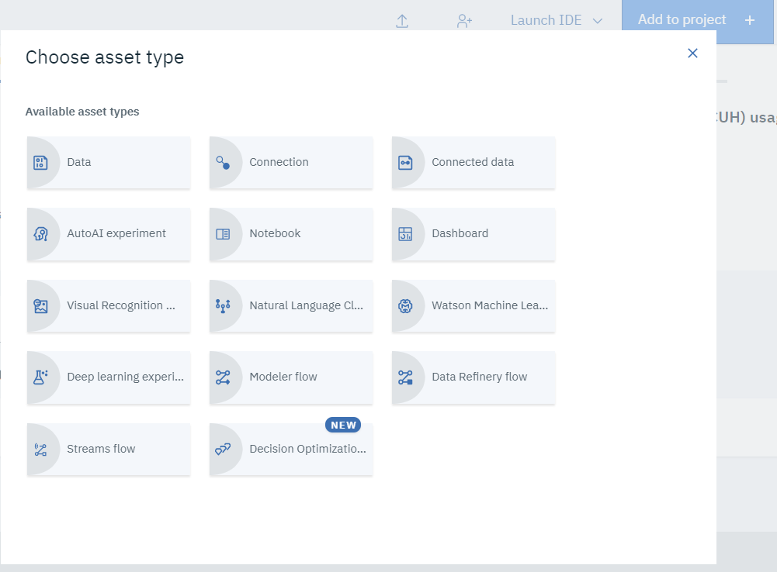
Add to Project

Slide 17
Watson Studio supports the Data Science Lifecycle
Build, train, deploy, and monitor at scale ML/DL workflows to infuse AI into the enterprise to drive innovation.
Connect to Data
Find Governed Data
Save and Deploy
Build Model
Prepare Data
Monitor and Manage
Create Project
Research Topics

Slide 18
Watson Studio Gallery
Research Topics
Built-in learning to get started
The Gallery includes notebooks, and data sets
Copy notebooks or Data Sets into projects
Continuously updated in IBM’s managed service

Slide 19
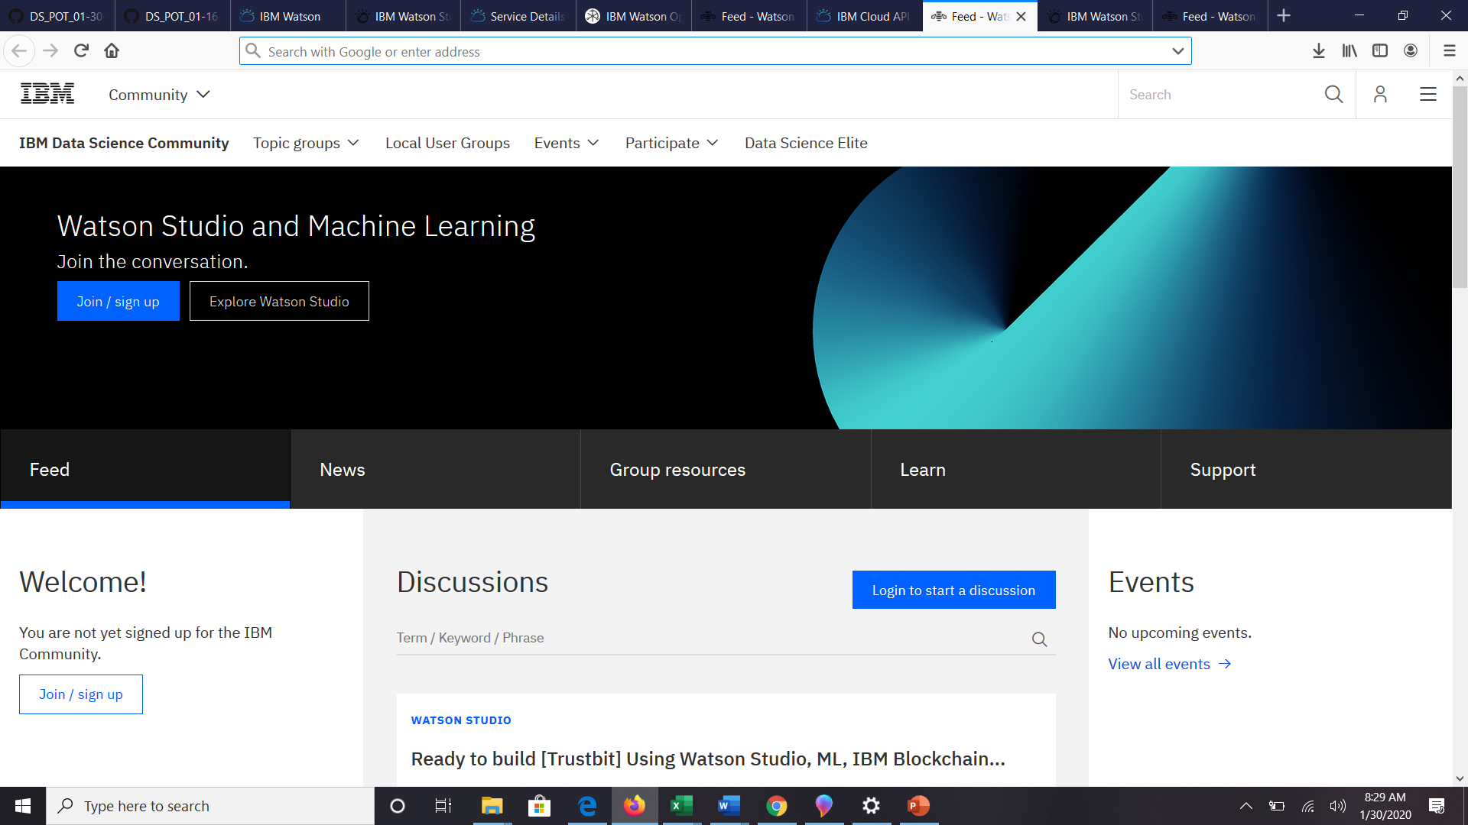
Watson Studio Community
Research Topics

Slide 20
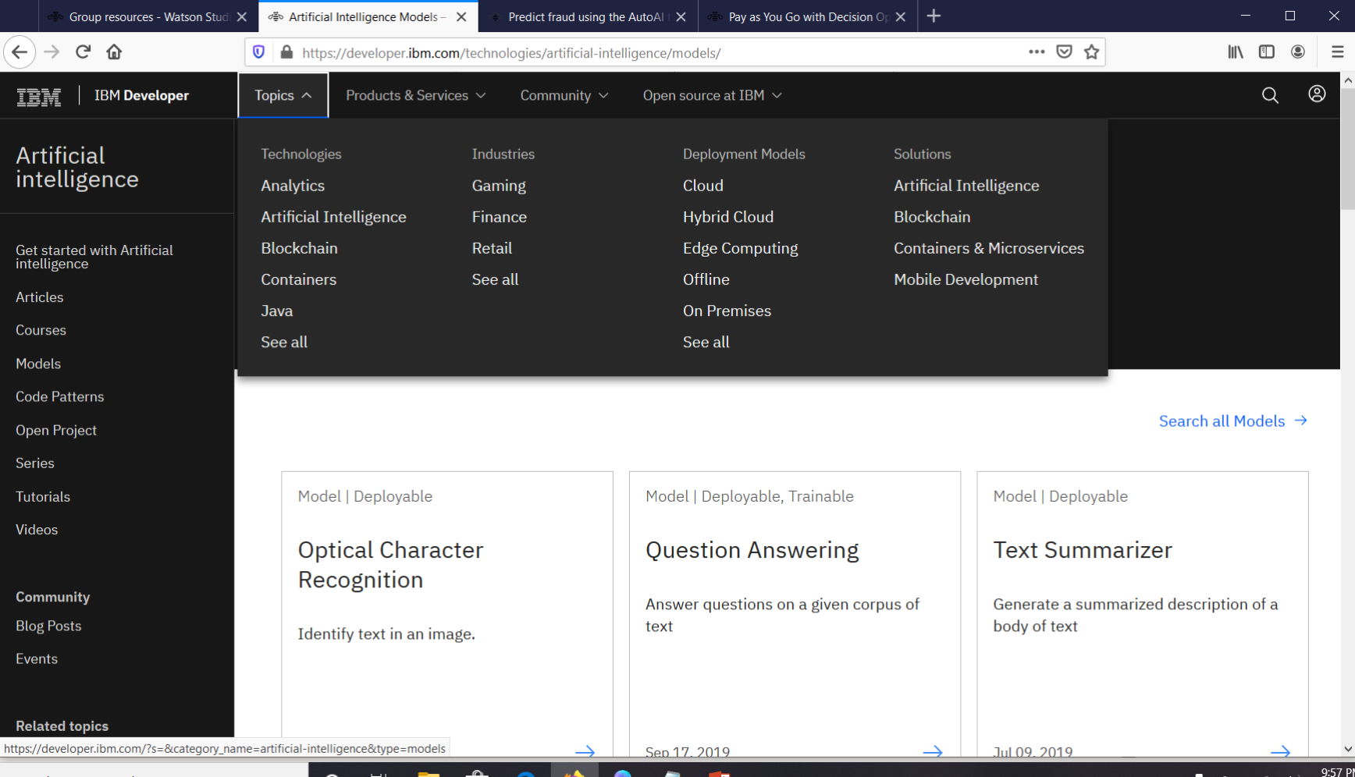
developer.ibm.com
Research Topics

Slide 21
Watson Studio supports the Data Science Lifecycle
Build, train, deploy, and monitor at scale ML/DL workflows to infuse AI into the enterprise to drive innovation.
Connect to Data
Prepare Data
Create Project
Research Topics
Find Governed Data
Build Model
Monitor and Manage
Save and Deploy

Slide 22
Watson Knowledge Catalog Features
Find Governed Data
Unlock tribal knowledge and unleash knowledge workers
Find data (structured, unstructured) and AI assets (e.g., ML/DL models, notebooks, Watson Data Kits) in the Knowledge Catalog with intelligent search and giving the right access to the right users.
Discover assets, profiling, classification
Policy, rule authoring
Policy, rule enforcement
Asset Usage Statistics

Slide 23
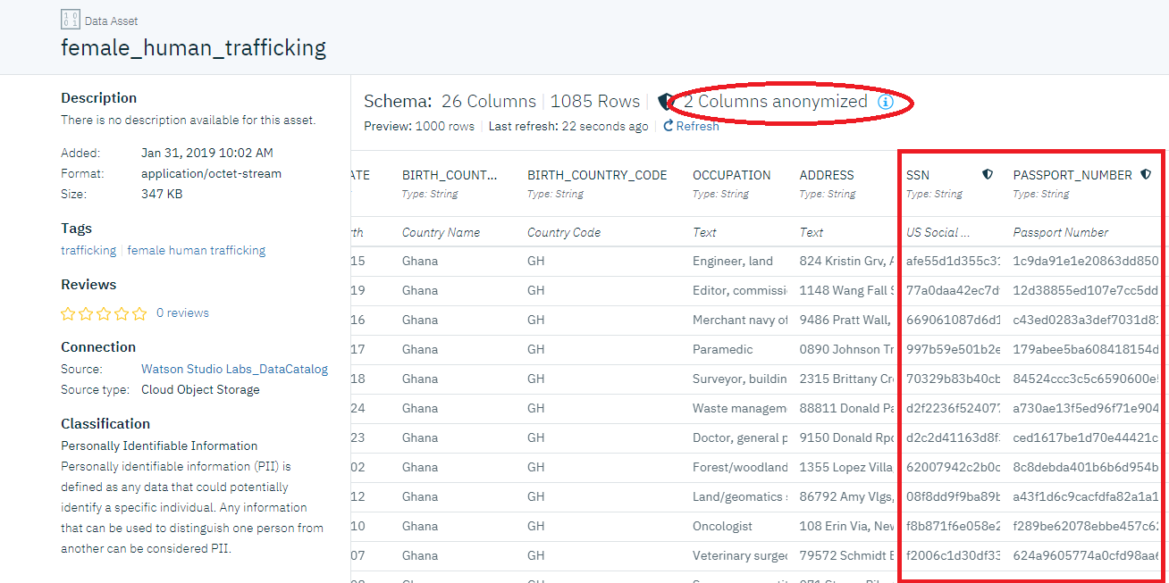
Watson Knowledge Catalog Features
Find Governed Data

Slide 24
Watson Studio supports the Data Science Lifecycle
Build, train, deploy, and monitor at scale ML/DL workflows to infuse AI into the enterprise to drive innovation.
Connect to Data
Prepare Data
Create Project
Resarch Topics
Find Governed Data
Build Model
Monitor and Manage
Save and Deploy

Slide 25
Watson Studio Connection Features
Connect to Data
Upload files
Connectors to Structured and Unstructured, On-prem and Cloud data sources.
Wizard based connection definition and code generation

Slide 26
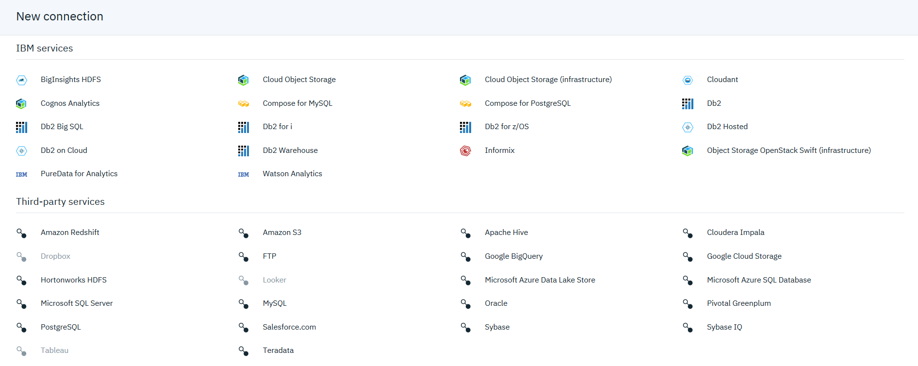
Connection Options
Connect to Data

Slide 27
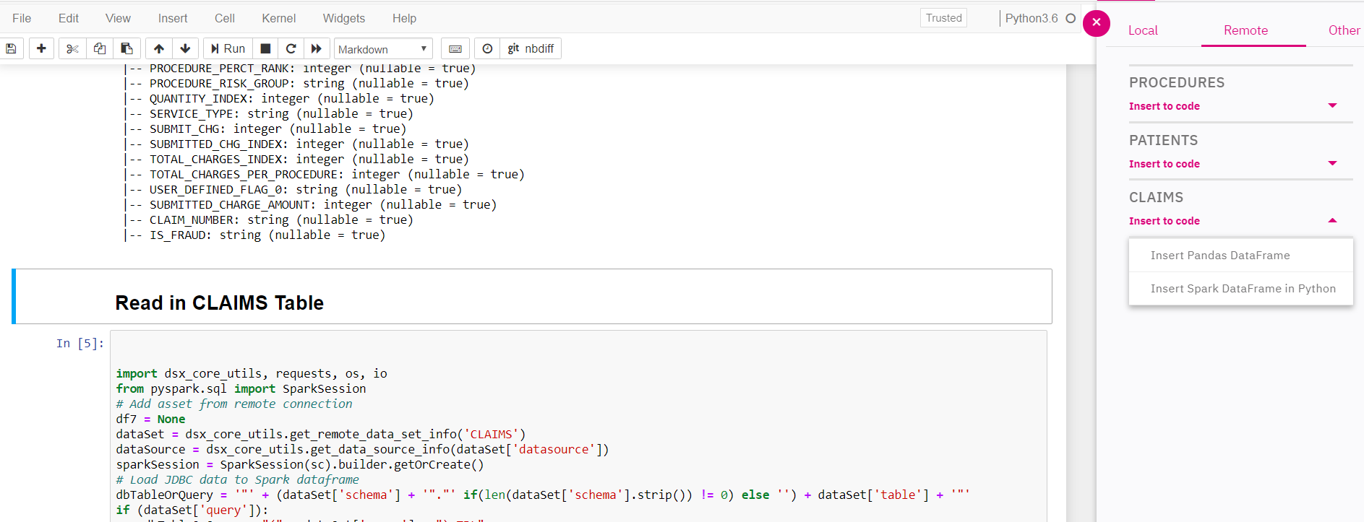
Notebook Screenshot
Connect to Data

Slide 28
Watson Studio supports the Data Science Lifecycle
Build, train, deploy, and monitor at scale ML/DL workflows to infuse AI into the enterprise to drive innovation.
Connect to Data
Prepare Data
Create Project
Resarch Topics
Find Governed Data
Build Model
Monitor and Manage
Save and Deploy

Slide 29
Watson Studio Data Refinery Features
Prepare Data
Making Data fit for use
Data Refinery tool to profile, visualize, and shape data.
Create data preparation pipelines via point and click capability on subset of data
Cleanse the data: fixing or removing data that is incorrect, incomplete, improperly formatted, or duplicated
Shape the data: customize data by filtering, sorting, combining, or removing columns, and performing operations
Run the pipeline on all the data
Manually (on demand)
Automated (scheduled)

Slide 30
Watson Studio supports the Data Science Lifecycle
Build, train, deploy, and monitor at scale ML/DL workflows to infuse AI into the enterprise to drive innovation.
Connect to Data
Prepare Data
Create Project
Resarch Topics
Find Governed Data
Build Model
Monitor and Manage
Save and Deploy

Slide 31
Watson Studio Model Building Features
Build Model
The best of open source and IBM Watson tools to create start-of-the-art data products
Open Source Tools
Jupyter Notebooks**
RStudio and Shiny
Libraries- scikit-learn**, XGBoost**, Spark**, TensorFlow, Caffe, Keras, PyTorch
IBM Tools
AutoAI **
SPSS Modeler**
Neural Network Modeler
Experiment Builder
Natural Language Classifier Model
Visual Recognition Model
Train at scale on GPUs and distributed compute
** in hands-on labs

Slide 32
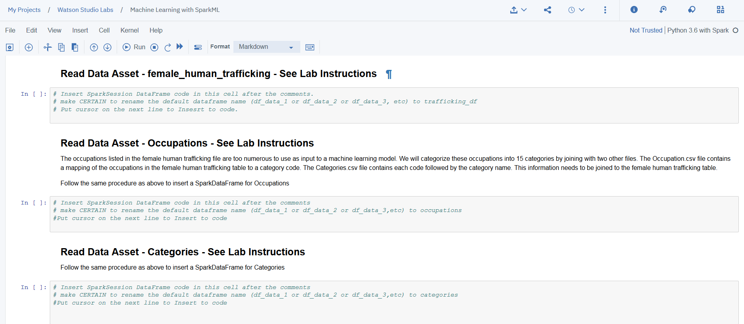
Jupyter Notebook
Build Model

Slide 33
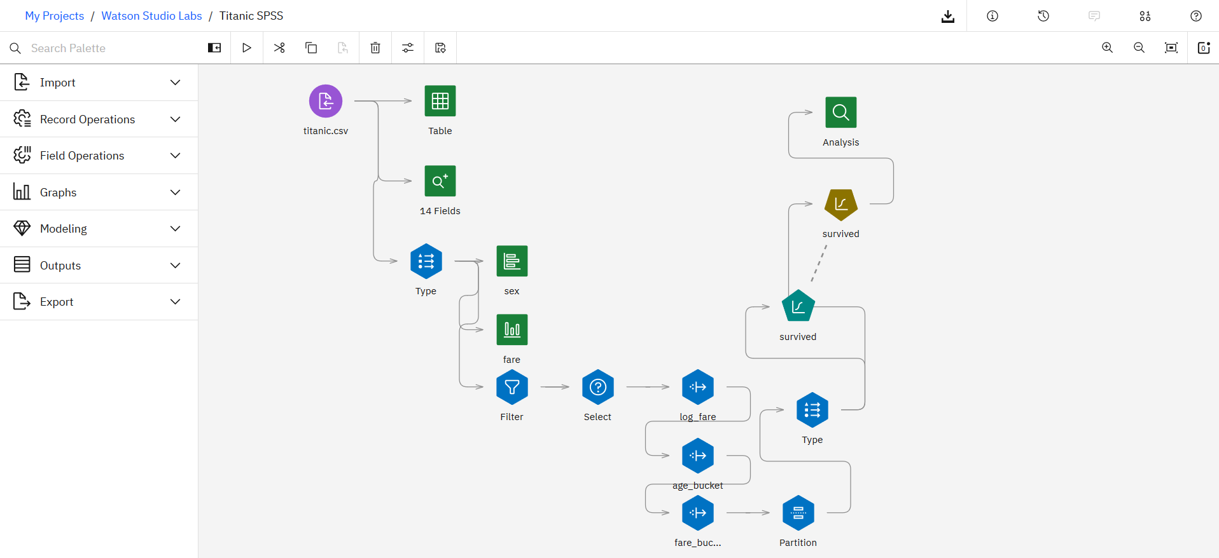
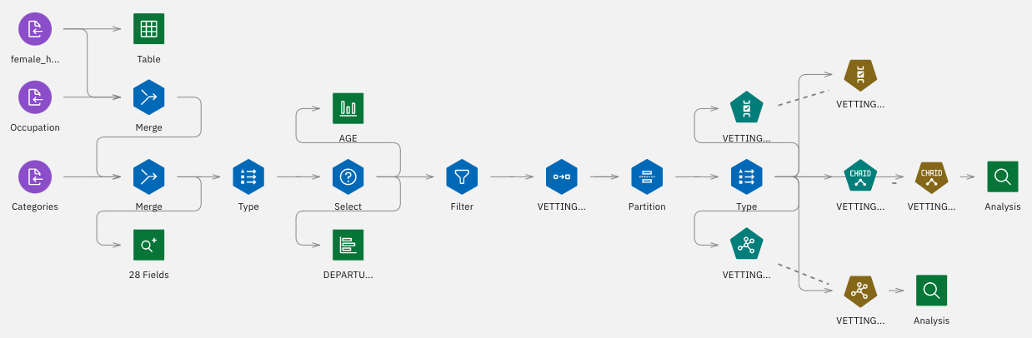
SPSS Modeler
Build Model

Slide 34




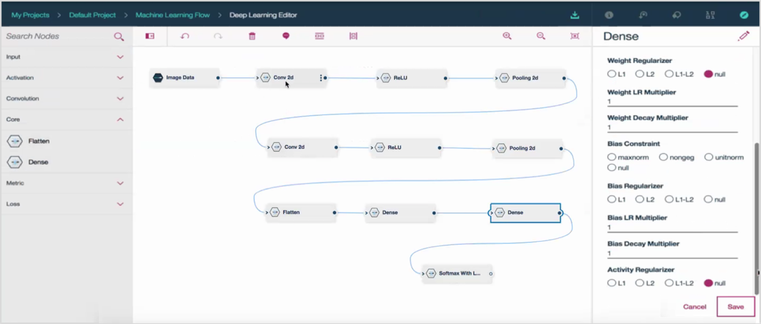
Neural Network Modeler
Build Model
An intuitive drag-and-drop, no-code interface for designing neural network structures using the most popular deep learning frameworks. Quickly capture your network design then single click export for experimental optimization.
Supported Frameworks
Real-time validation of network flow
Define layer configuration
Choose optimizer params
Drag-and-drop
network layers
Generate CPU or GPU compatible code
Save as popular framework code
Export as a python notebook
Execute as batch experiment

Slide 35
Experiment Builder
Build Model
10’s-100’s experiments
neural
network
batch_size
dropout
learning_rate
…
hyperparameters
designs
varies
trains
100’s-1000’s
models
evaluates
Experiment Builder
supports the end-to-end workflow
Notes:
Traditional machine learning focuses on selecting the right algorithm then tweaking the few available parameters. Deep learning significantly increases the complexity of model building by requiring data scientists to first design then tweak the dozens of interrelated parameters in neural networks structures. But AI is where all the complexity converges. We speak about AI as though it’s a single model or neural network but it’s not. AI is about multiple algorithms, neural networks, data and support systems working together as a system. So the challenge of AI is not about training a single model but about architecting numerous data-driven services which that the underlying complexity and hidden and emerges as a seemingly cognitive system.

Slide 36
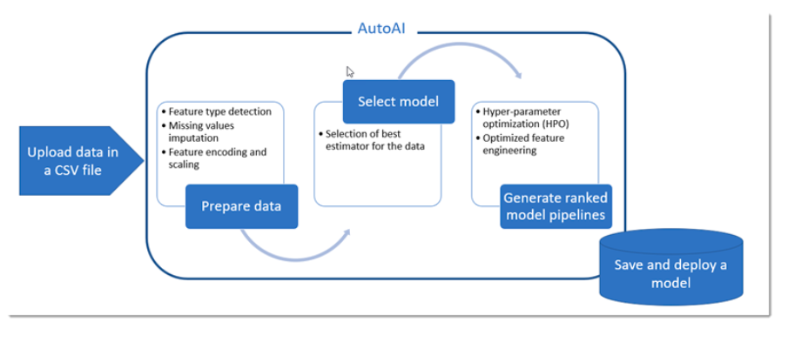
AutoAI
Build Model

Slide 37
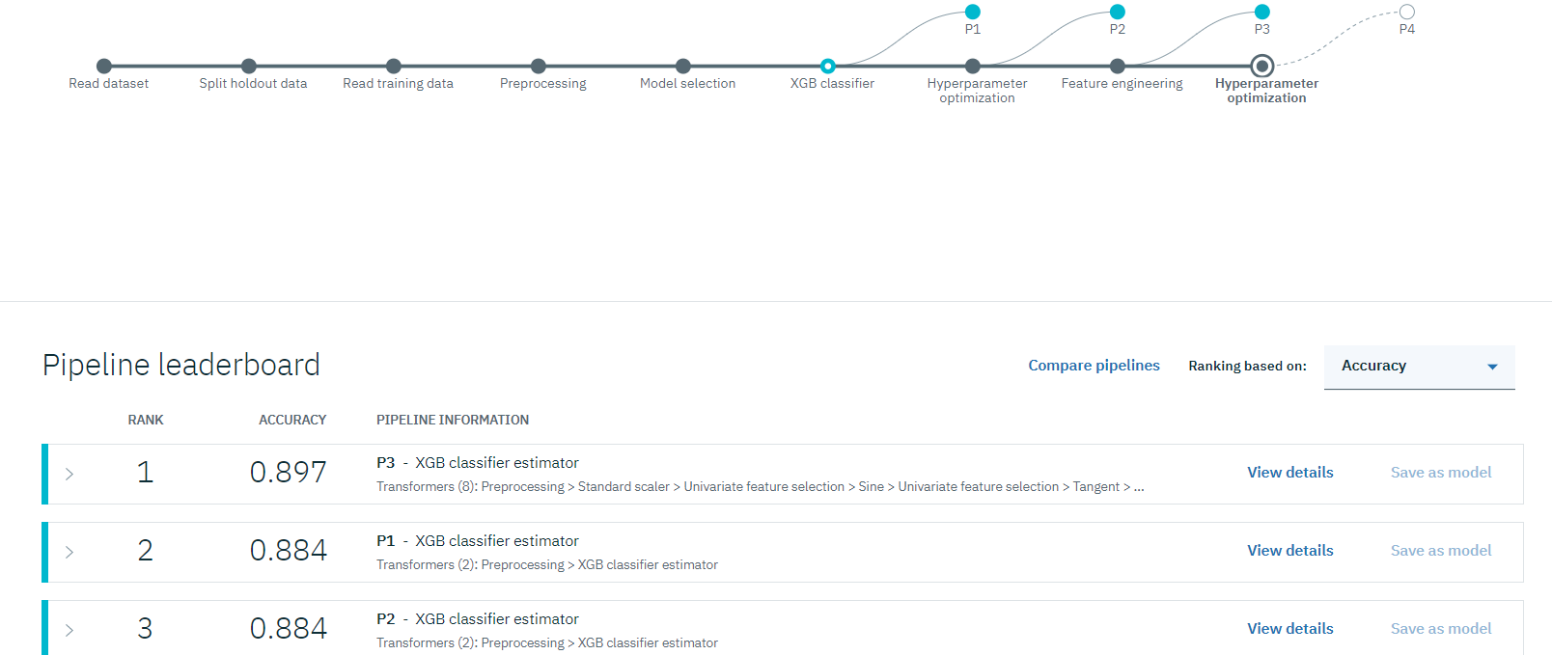
AutoAI
Build Model

Slide 38
Watson Studio supports the Data Science Lifecycle
Build, train, deploy, and monitor at scale ML/DL workflows to infuse AI into the enterprise to drive innovation.
Connect to Data
Prepare Data
Create Project
Resarch Topics
Find Governed Data
Build Model
Monitor and Manage
Save and Deploy

Slide 39
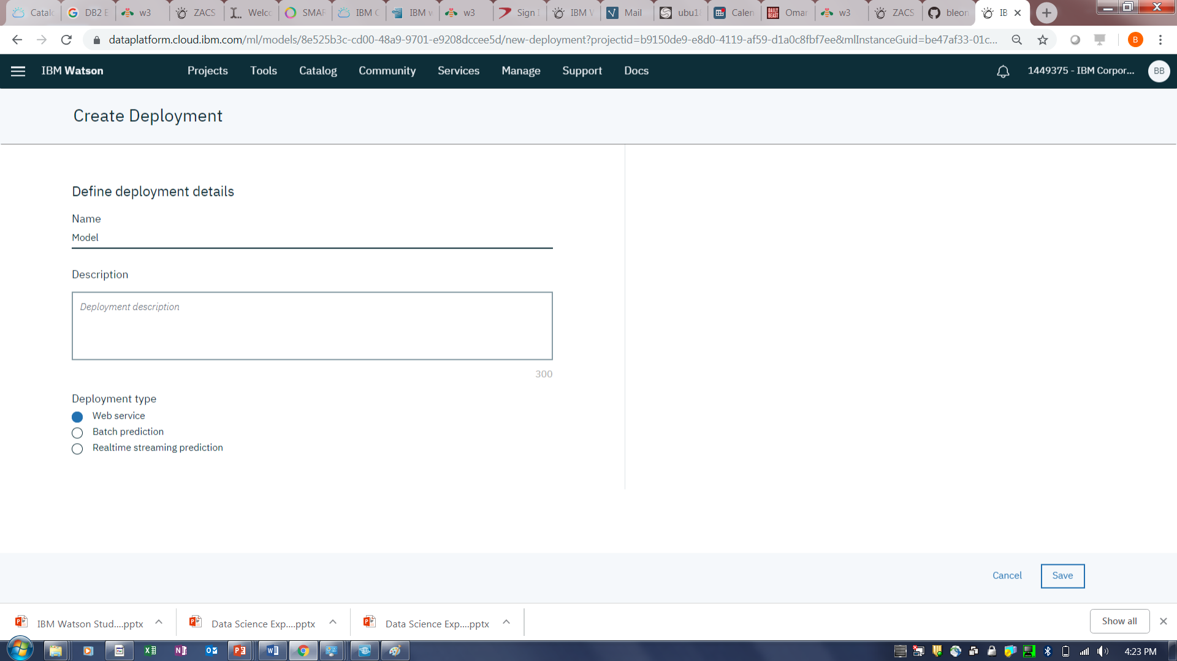
Watson Studio Save and Deploy Models
Save and Deploy
Save and Deploy Models with Watson Machine Learning

Slide 40
Watson Studio Save and Deploy Trained Models
Save and Deploy Models with Watson Machine Learning
Watson Machine Learning
train
infrastructure
deploy
infrastructure
invoke
REST
API
prediction
App
save
REST
API
prediction
App
artifact
repository
deploy
hosted
models
REST
API
prediction
App
REST
API
prediction
App

Slide 41
Watson Studio Save and Deploy Features
Save and Deploy
Save and Deploy Models with Watson Machine Learning
Watson Machine Learning API to save/load models to/from repository
Watson Machine Learning API to deploy saved models easily and have them scale automatically.
Watson Machine Learning API to invoke deployed models
Notes:
And with our Deployment Manager, without any coding, you can easily deploy a trained model on prem, in the cloud, or remotely to a Spark cluster in HortonWorks Data Platform.
Also, our model management dashboard shows the predictive accuracy of your models. Data scientists and IT can review, and even schedule evaluation of deployed models, so you spend less of your time managing what’s in production, and more time on driving business results.

Slide 42
Watson Studio supports the Data Science Lifecycle
Build, train, deploy, and monitor at scale ML/DL workflows to infuse AI into the enterprise to drive innovation.
Connect to Data
Prepare Data
Create Project
Resarch Topics
Find Governed Data
Build Model
Monitor and Manage
Save and Deploy

Slide 43
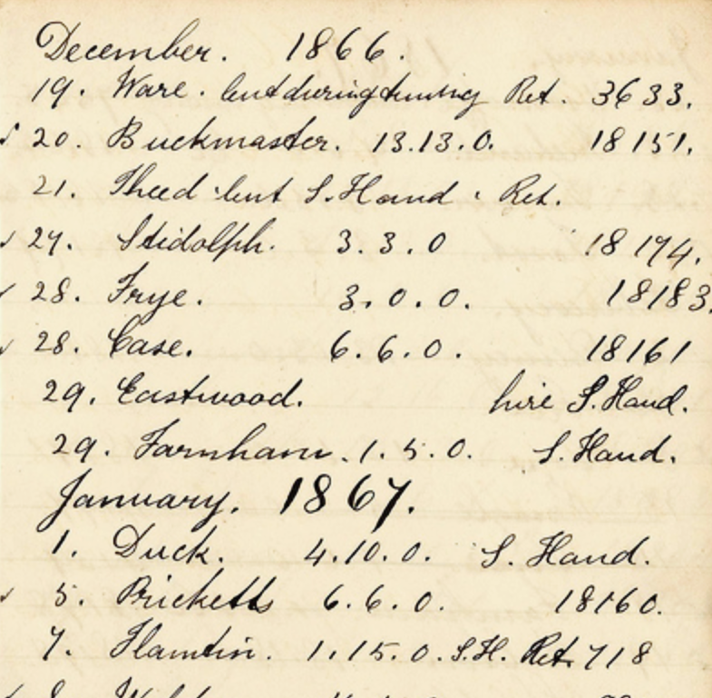

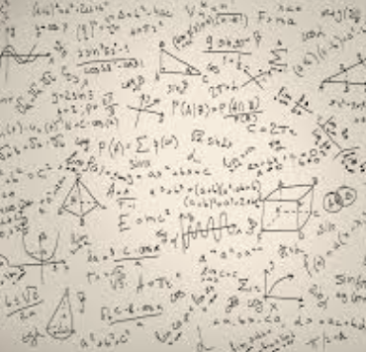

Our vision for Trusted AI
Monitor and Manage
Pillars of trust, woven into the lifecycle of an AI application
#21, #32, #93
#21, #32, #93
Is it
accurate?
Is it fair?
Is it easy to understand?
Did anyone tamper with it?
Notes:
… and as they did we realized that they can have profound implications on our society. Once upon a time we used to build algorithms for accuracy, but that is changing. There is a realization that if they are going to be governing important aspects of our lives, they need to be more than just accurate – we need to trust them. So what does it take to trust and algorithmic decision?

Slide 44
Watson OpenScale
Monitor and Manage
Trust and Transparency
Intelligently delivers bias mitigation help
Provides traceability & auditability of AI predictions made in production applications
Tracks AI accuracy in applications
Explains an outcome in business terms
Drift Detection
Automation
Automatically detects and mitigates bias in model output, without affecting currently deployed model or outcomes
Open By Design
Monitor models deployed on third party model server engines
Deploy behind enterprise firewall or on IaaS provider

Slide 45
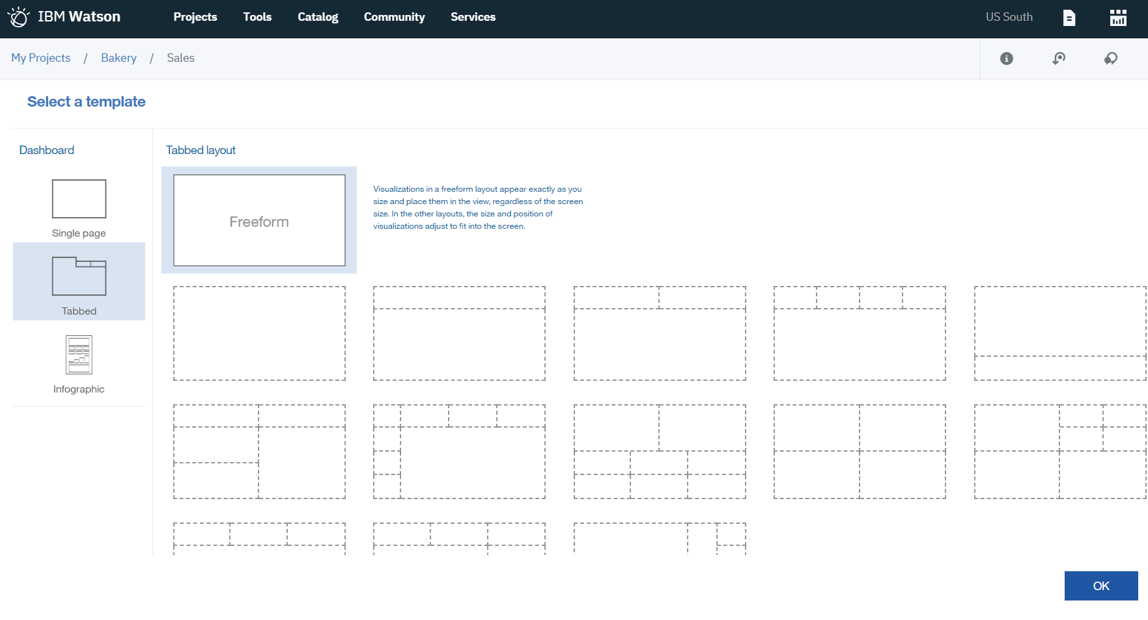
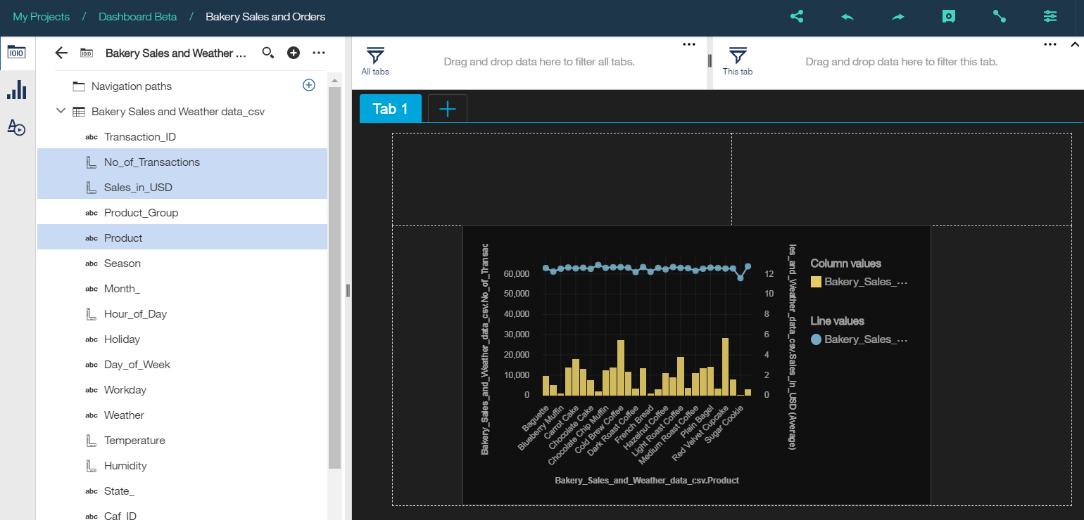
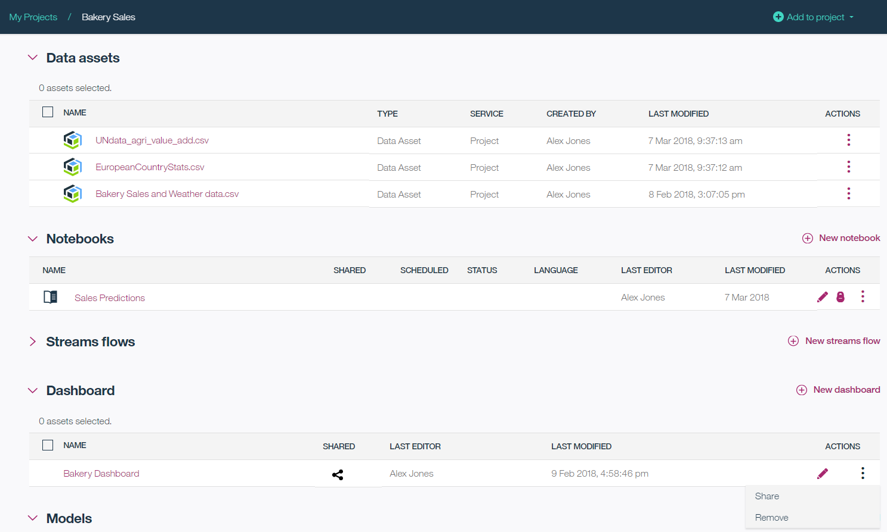
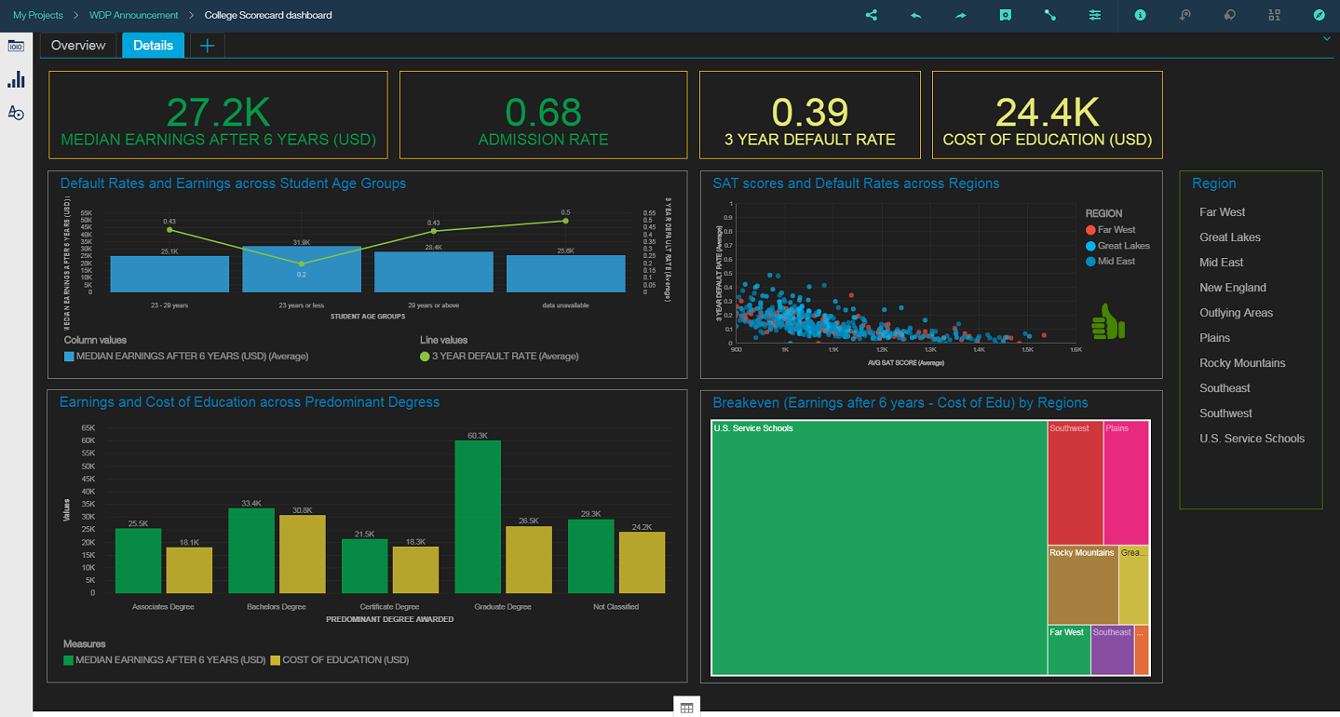
Watson Studio Dynamic Dashboards
Making insights available to all
3
Notes:
Visualize – represent analytical results as compelling interactive graphics
Immediately view effective visualizations fitting the data selected.
Choose your favorite graph or chart type from palette of options
Apply Filters to individual or multiple visualizations.
Customize appearance with individual settings or dashboard themes.
Share - Deliver dashboards across the enterprise, providing insights where business decisions are made.
Collaborate on dashboards with other project users.
Share interactive dashboards through a public URL for use by others outside the platform.
Discover - Utilize enterprise data assets with confidence through projects and the Watson Knowledge Catalog.
Access data assets associated with your project
Data sources may be local uploaded files or connections to relational sources.
Search for data through the data catalog, then explore using dashboards
1) Create a Dashboard from a selection of easy to use formatted templates
2) Create a visualization simply by selecting data items from the tree and dragging onto the canvas. System chooses effective visualization based on number and type of data selected.
3) How dashboards are integrated into projects & Share Dashboard with others via URL
4) Create compelling and comprehensive dashboards without coding or knowledge of SQL

Slide 46
Watson Studio Takeaways
Integrated Collaboration Environment
Choice of Tools for the full AI lifecycle
Support for all levels of expertise
Data Scientists, Subject Matter experts, Business Analysts & Developers all in one environment to accelerate innovation, collaboration and productivity
Built-in learning to get started or go the distance with advanced tutorials
Best in-breed open source and IBM tools that support the end-to-end AI lifecycle
Choice of code or no-code tools to build and train your own ML/DL models or easily train and customize pre-trained Watson APIs
Use Watson smarts and recommendations for the best algorithms to use given your data, OR
Use the rich capabilities and controls to fine tune your models
Multiple Deployment Options
Model lifecycle & management
Integrated with Knowledge Catalog
Watson Studio on IBM Cloud – Managed offering
Watson Studio Local – Private Cloud, Public Cloud-(IBM, Azure, AWS)
Watson Studio Desktop
Deploy models into production then monitor them to evaluate performance.
Capture new data for continuous learning and retrain models so they continually adapt to changing conditions.
Intelligent discovery of data and AI assets that enables reuse & improves productivity
Seamlessly integrated for productive use with Machine Learning and Data science
Powerful governance tools to control and protect access to data

Slide 47
Outline
Data Science Overview
Watson Studio Overview
Lab Overview

Slide 48
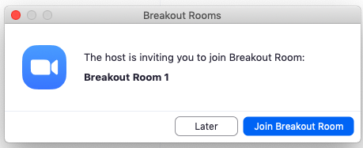
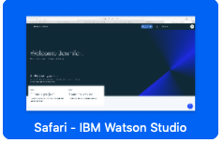


Breakout Rooms
Notes:
We would show this chart BEFORE the labs begin.

Slide 49
Lab Use Case: Female Human Trafficking
Input
Generated fake travel records based on incoming custom forms.
Subset of records were vetted as “high”, “medium”, or “low” risk for Female Human Trafficking by an analyst.
Goal is to train a model on the vetted data to be able to score the unvetted travel records into high, medium, or low categories.

Slide 50
Lab Data
Field | Description
UUID | Hash-based unique identifier
VETTING_LEVEL | Analyst vetting status : 100- PENDING, 10 – HIGH, 20 – MED, 10 - LOW
NAME | Person name
GENDER | Person Gender
AGE (SPSS Modeler) | Person age at time of travel
BIRTH_DATE (Notebook) | Person birth date
BIRTH_COUNTRY | Person full birth country
BIRTH_COUNTRY_CODE | Person ISO 2 country
OCCUPATION CATEGORY | Person occupation as declared on form
ADDRESS | Person US address
SSN | Person Social Security Number
PASSPORT_NUMBER | Person Passport Number
PASSPORT_COUNTRY | Person Passport Issuing Country
PASSPORT_COUNTRY_CODE | Person Passport Issuing Country ISO 2 Code
COUNTRYIES_VISITED | The countries visited as declared on form
COUNTRIES_VISITED_COUNT | The number of countries visited as declared on form
ARRIVAL_AIRPORT_COUNTRY_CODE | ARRIVAL Airport country code ISO2
AIRPORT_ARRIVAL_IATA | ARRIVAL Airport 3 character code
AIRPORT_ARRIVAL_MUNICIPALITY | ARRIVAL Airport Municipality Derived from Code
ARRIVAL_AIRPORT_REGION | ARRIVAL Airport Region Derived from Code
DEPARTURE_AIRPORT_COUNTRY_CODE | DEPARTURE Airport Country code ISO2
DEPARTURE_AIRPORT_IATA | DEPARTURE Airport 3 character code
DEPARTURE_AIRPORT_MUNICIPALITY | DEPARTURE Airport Municipality Derived from Code.
Target
Features

Slide 51
Lab Tips
Watson Studio url: dataplatform.ibm.com
Labs are in www.github.com/bleonardb3/DS_POT_04-30-2020 repository.
Instructions for each Lab are in the README file in the respective Lab folder.
Cloud development enables making frequent improvements in the user interface. We reviewed the lab instructions and made screen updates so they should be pretty faithful to the user interface. Small differences may occur but shouldn’t get in the way of successfully completing the labs.
Do not use Internet Explorer or Edge as the browser. For Mac users do not use Safari.
All of the Labs should be done in the project that you created in Lab-1

Slide 52
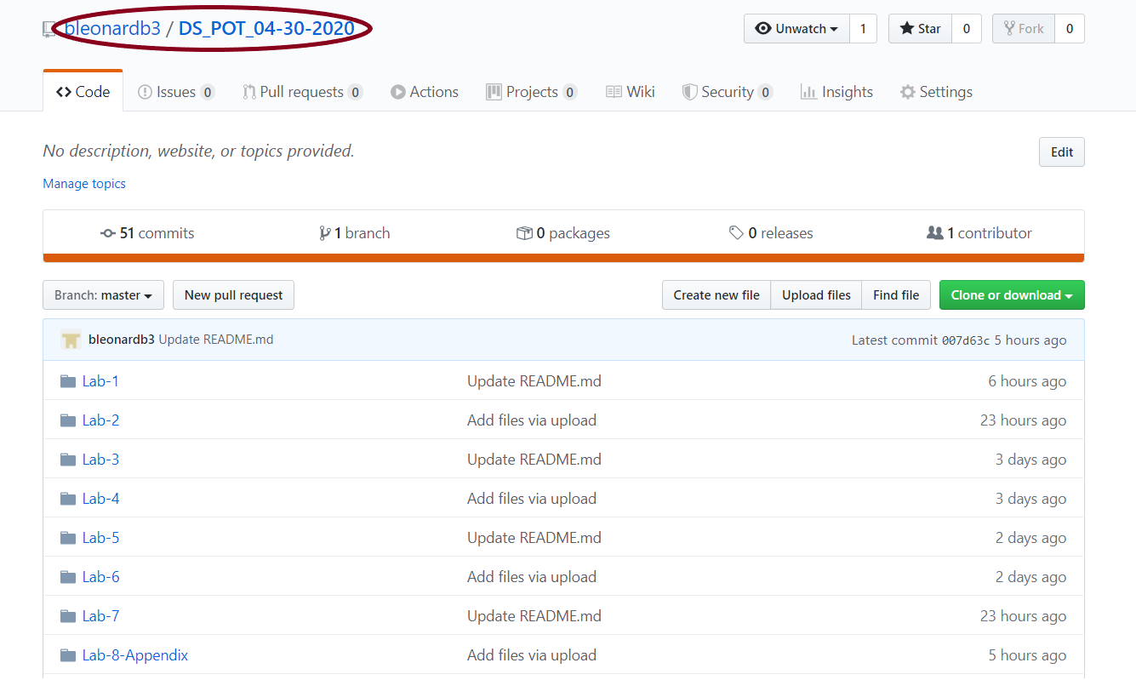
Github Repository

Slide 53
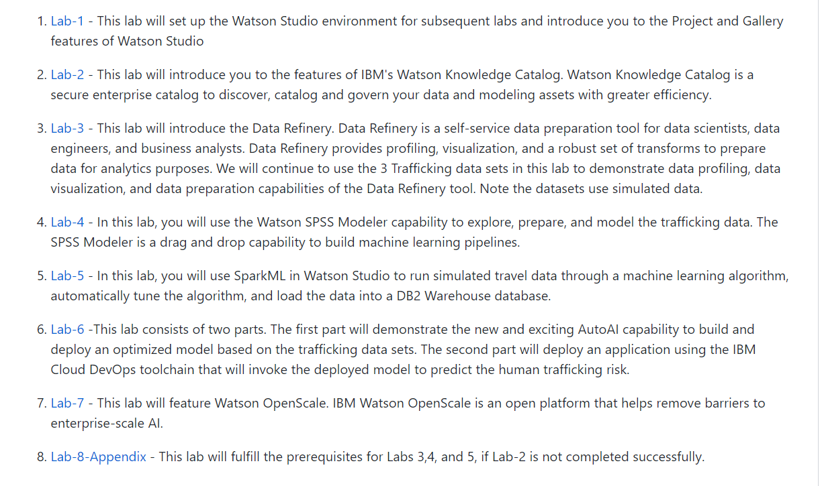
Github Repository Readme

Slide 54
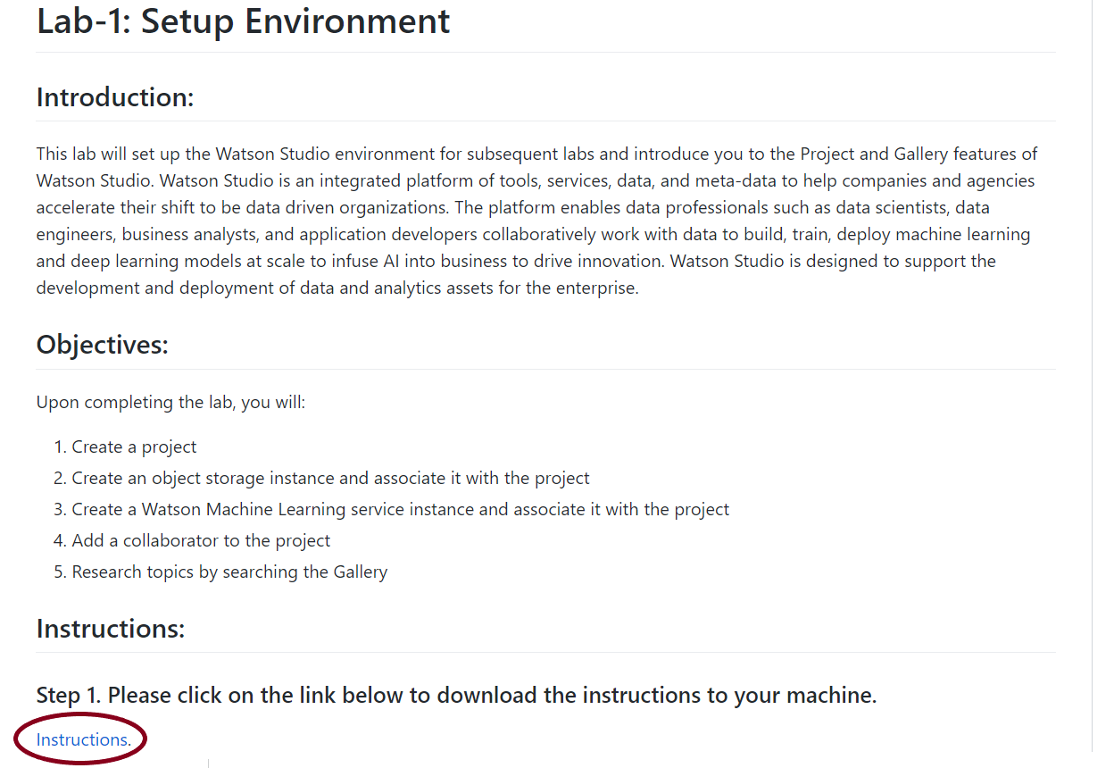
Github Repository
Lab-1 Readme

Slide 55



Browser Tabs

Slide 56
Lab-1: Set up Environment
Introduction:
This lab will set up the Watson Studio environment for subsequent labs and introduce you to the Project and Community features of Watson Studio.
Objectives:
Upon completing this lab, you will know how to:
Create a project
Create an object storage instance and associate it with the project
Create a Watson Machine Learning service instance and associate it with the project
Add a collaborator to the project
Research topics by searching the Gallery
Notes:
So, what is DSX Local?
DSX Local is a private cloud platform which provides data scientists with easy
access to complex analytics
DSX Local is very similar to the data science experience in the public cloud. Both provide projects which help teams share work and collaborate, and both include tools which are commonly used by data scientists such as Jupyter notebooks and RStudio
The main difference between DSX Local and the data science experience in the public cloud is that DSX Local runs on hardware provided by the customer and the customer also manages the DSX Local software themselves
DSX Local comes with all the software needed for it to run, although it can integrate with other existing customer systems. These include: existing databases and files in HDFS, customer LDAP servers for authentication and existing spark clusters and object storage
Note that some of these options will only be supported in a future release

Slide 57
Lab-2: Introduction to Watson Knowledge Catalog
Introduction:
This lab will introduce you to the features of IBM's Watson Knowledge Catalog. Watson Knowledge Catalog is a secure enterprise catalog to discover, catalog and govern your data and modeling assets with greater efficiency.
Objectives:
The goal of the lab is to gain familiarity with the features of the Watson Knowledge Catalog. Upon completing the lab, you will know how to:
Create a governed catalog
Add a member to the catalog
Add Data Assets to the catalog
Search the catalog
Edit/Review/Profile a Data Asset
Demonstrate access control features
Create and enforce policy
Push the Data Assets to a project.
Notes:
So, what is DSX Local?
DSX Local is a private cloud platform which provides data scientists with easy
access to complex analytics
DSX Local is very similar to the data science experience in the public cloud. Both provide projects which help teams share work and collaborate, and both include tools which are commonly used by data scientists such as Jupyter notebooks and RStudio
The main difference between DSX Local and the data science experience in the public cloud is that DSX Local runs on hardware provided by the customer and the customer also manages the DSX Local software themselves
DSX Local comes with all the software needed for it to run, although it can integrate with other existing customer systems. These include: existing databases and files in HDFS, customer LDAP servers for authentication and existing spark clusters and object storage
Note that some of these options will only be supported in a future release

Slide 58
End-to-End Data Science using Watson Studio
Lunch Break. We will return for review at 12:30 pm.
Notes:
Cover slide. We’ll leave this up during Frank’s welcome.

Slide 59
Lab-3: Introduction to the Data Refinery
Introduction:
In this lab, you will use the Watson Studio Data Refinery to profile data, visualize data, and prepare data for modeling.
Objectives:
Upon completing the lab, you will know how to:
Profile the data
Visualize the data to gain a better understanding
Prepare the data for modeling
Run the sequence of data preparation operations on the entire data set.

Slide 60
Lab-4: SPSS Modeler
Introduction:
In this lab, you will use the Watson Studio SPSS Modeler capability to explore, prepare, and model trafficking data. The SPSS Modeler is a drag and drop capability to build machine learning pipelines.
Objectives:
Upon completing the lab, you will:
Become familiar with the Watson Studio SPSS Modeler capability
Profile the data set
Explore the data set with visualizations
Transform the data
Train/Evaluate a machine learning mode.

Slide 61
End-to-End Data Science using Watson Studio
We will return for lecture at
2:00 pm. Please work on labs 3 and 4
Notes:
Cover slide. We’ll leave this up during Frank’s welcome.

Slide 62
Categories of Machine Learning
Supervised learning
The program is “trained” on a pre-defined set of “training examples”, which then facilitate its ability to reach an accurate conclusion when given new data
The algorithm is presented with example inputs and their outcomes (labels)
The goal is to learn a general rule that maps inputs to outputs
Unsupervised learning
No labels are given to the learning algorithm, leaving it on its own to find structure (patterns and relationships) in its input

Slide 63
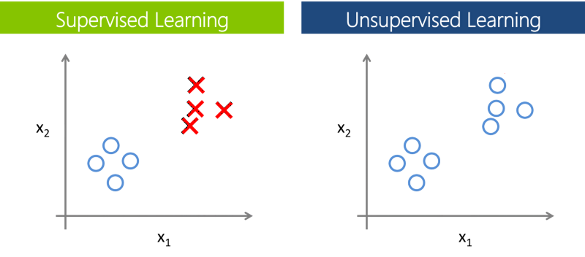
Supervised vs. Unsupervised Learning
Notes:
In supervised learning

Slide 64
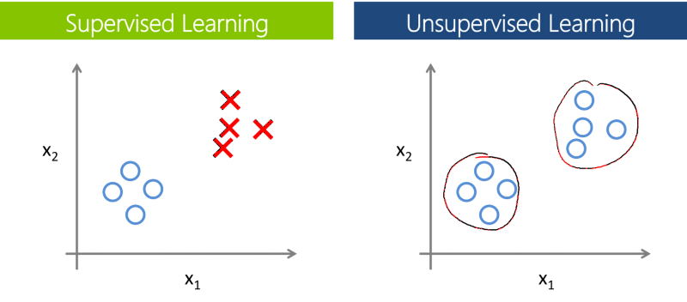
Supervised vs. Unsupervised Learning
Notes:
In supervised learning

Slide 65
Preprocessing: Matrix for Machine Learning
Known as:
Attributes
Features
Predictor variables
Explanatory variables
a1 a2 a3 a4 a5 a6 a7 a8 a9 t
Scale variables:
Continuous variables, which can be measured on an interval scale or ratio scale
‘Weight’, ‘Temperature’, ‘Salary’, etc…
Categorical variables:
Data with a limited number of distinct values or categories (nominal or ordinal)
‘Hair color’, ‘Gender’, ‘Grape varieties’, etc…
Known as:
Label
Target variable
Dependent variable
Scale or Categorical

Slide 66
Training, testing, & validation sets
During the model development process, supervised learning techniques employ training and testing sets and sometimes a validation set.
Historical data with known outcome
Data is randomly split into training, testing, and/or validation sets (mutually exclusive records)
Why?
Training set
Build the model
Tune the parameters
Validation set
Assess model quality during training/tuning process
Avoid overfitting the model to the training set
Test set
Estimate accuracy or error rate of model after tuning
Used to compare multiple models

Slide 67
K-Fold Cross Validation
Instead of using a separate validation set
Shuffle Training Samples and sub-divide into “K” folds (groups)
Train “K” models using K-1 folds as training data and 1 Fold as Test Data
For example, K=4
Model 1 Train on 1,2,3 Test on 4 – calculate and store E1 (Error)
Model 2 Train on 2,3,4 Test on 1 – E2
Model 3 Train on 3,4,1 Test on 2 - E3
Model 4 Train on 4,1,2 Test on 3 - E4
E = (E1+E2+E3+E4)/4
A common value for K is 10
Notes:
Cross Validation is used when you don’t want to “waste” training data by having separate validation and test subsets.

Slide 68
Spark and Spark ML
Spark – why should I use it?
Spark is a highly scalable runtime environment for analytics
Provides the runtime engine and API
Supports multiple languages: Python (PySpark), R (SparkR) and Scala
If you want to take advantage of Spark scalability and performance, you have to use Spark APIs
Example (Python): Spark data frame vs. Pandas, Spark algorithms vs. scikit-learn
It’s possible to “mix and match” Spark and non-Spark code in a single notebook: the runtime environment will switch automatically
For example, use Python API for data understanding and SparkML for modeling
Spark Machine Learning API: https://spark.apache.org/docs/latest/ml-guide.html
Supported versions of Spark: https://www.ibm.com/software/reports/compatibility/clarity/prereqsForProduct.html
Notes:
As we already mentioned, DSX includes Spark. Spark is a highly scalable runtime environment that was designed specifically for running analytical workloads.
To take advantage of Spark features, data scientists have to use Spark APIs. Spark APIs are available in multiple programming languages, including Python, R, and Scala. The Python API for Spark is called PySpark, and the R interface is SparkR.
Many customers bring in existing Python and R code to DSX. This code will run in DSX IDEs because in addition to Spark runtime, DSX includes R and Python servers. However, if they want to use Spark, they will need to use Spark APIs. In other words, just because you brought existing Python code into DSX, it doesn’t mean that it will automatically run in Spark.
It is possible to “mix and match” Spark and non-Spark code in a notebook IDE. Spark is a newer API compared to Python and R, and that’s why data scientists often use both. For example, in a single notebook you can use Python API for data understanding and SparkML API for modeling.
For supported versions of Spark, see the DSX Local Compatibility report.

Slide 69
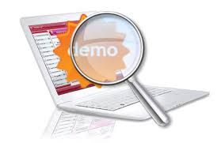
Lab-5: Flow
Read in data from Cataloged Assets
Join trafficking, job categories, occupations data
Identify Labels
Label the data (“VETTING_LEVEL”)
Select features
Feature Engineering (Transformation)
StringIndexer (occupation, country, gender, birth year variables)
VectorAssembler
Normalizer
Define Model and Setup Pipeline
Naïve Bayes
Random Forest
Train the Model
Split input data into Training (70%) and Test (30%) DataFrames
Cache the resulting DataFrames
Fit the Pipeline to the Training data set

Slide 70
Lab-5: Flow (continued)
Evaluate the resulting predictions
Area under the ROC curve
Tune the model (hyperparamaters)
Build Parameter Grid
Cross-evaluate to find the best model
Score the unvetted records
Use Best Model to Score unvetted records (VETTING LEVEL == 100)
Write results into the Database
Save the model in the Model Repository
Model properties can be saved as well (e.g Area under the ROC curve)

Slide 71
Lab-5: Machine Learning using SparkML
Introduction:
In this lab, you will use SparkML in Watson Studio to run generated travel data through a machine learning algorithm, automatically tune the algorithm, and load the prediction results into a DB2 on Cloud database.
Objectives:
Upon completing the lab, you will know how to use a Jupyter Notebook to:
Connect to a cataloged assets to read in data used for machine learning.
Select the target and features
Transform data
Declare a machine learning model.
Setup up the data transform and modeling pipeline
Train the model.
Evaluate the model.
Automatically tune the model.
Score data and load into a new DB2 table.
Save the trained model
Notes:
So, what is DSX Local?
DSX Local is a private cloud platform which provides data scientists with easy
access to complex analytics
DSX Local is very similar to the data science experience in the public cloud. Both provide projects which help teams share work and collaborate, and both include tools which are commonly used by data scientists such as Jupyter notebooks and RStudio
The main difference between DSX Local and the data science experience in the public cloud is that DSX Local runs on hardware provided by the customer and the customer also manages the DSX Local software themselves
DSX Local comes with all the software needed for it to run, although it can integrate with other existing customer systems. These include: existing databases and files in HDFS, customer LDAP servers for authentication and existing spark clusters and object storage
Note that some of these options will only be supported in a future release

Slide 72
Lab-6: AutoAI + DevOps
Introduction:
This lab consists of two parts. The first part will demonstrate the exciting AutoAI capability to build and deploy an optimized model based on the trafficking data set. The second part will deploy a web application using the IBM Cloud DevOps toolchain that will invoke the deployed model to predict the trafficking risk.
Objectives:
Upon completing the lab, you will:
Become familiar with the AutoAI feature of Watson Studio.
Train/Evaluate a machine learning model
Deploy a machine learning model.
-----------------------------------------------------------------------------------------------------
Deploy a Python Flask web application that we will configure to "call" the deployed machine learning model.
Configure the application to connect to the machine learning service.
Update the code in the application to specify the endpoint of the deployed model, and use DevOps to build and re-deploy the application.
Run the application to demonstrate the use of the deployed machine learning model to score the trafficking risk of a passenger.
Notes:
So, what is DSX Local?
DSX Local is a private cloud platform which provides data scientists with easy
access to complex analytics
DSX Local is very similar to the data science experience in the public cloud. Both provide projects which help teams share work and collaborate, and both include tools which are commonly used by data scientists such as Jupyter notebooks and RStudio
The main difference between DSX Local and the data science experience in the public cloud is that DSX Local runs on hardware provided by the customer and the customer also manages the DSX Local software themselves
DSX Local comes with all the software needed for it to run, although it can integrate with other existing customer systems. These include: existing databases and files in HDFS, customer LDAP servers for authentication and existing spark clusters and object storage
Note that some of these options will only be supported in a future release

Slide 73
End-to-End Data Science using Watson Studio
We will return for lecture at
3:30 pm. Please work on labs 5 and 6
Notes:
Cover slide. We’ll leave this up during Frank’s welcome.

Slide 74
Trusted AI
#21, #32, #93
#21, #32, #93
Is it
accurate?
Is it fair?
Is it easy to understand?
Did anyone tamper with it?

Slide 75





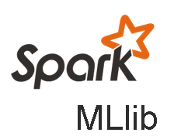

Watson OpenScale
Model build / train frameworks
Trust and Transparency
Intelligently delivers bias mitigation help
Provides traceability & auditability of AI predictions made in production applications
Tracks AI accuracy in applications
Explains an outcome in business terms
Provides drift detection
Automation
Automatically detects and mitigates bias in model output, without affecting currently deployed model or outcomes
Open by Design
Monitor models deployed on third party mode server engines
Deploy behind enterprise firewall or on IaaS provider.
Model serving environments

Slide 76
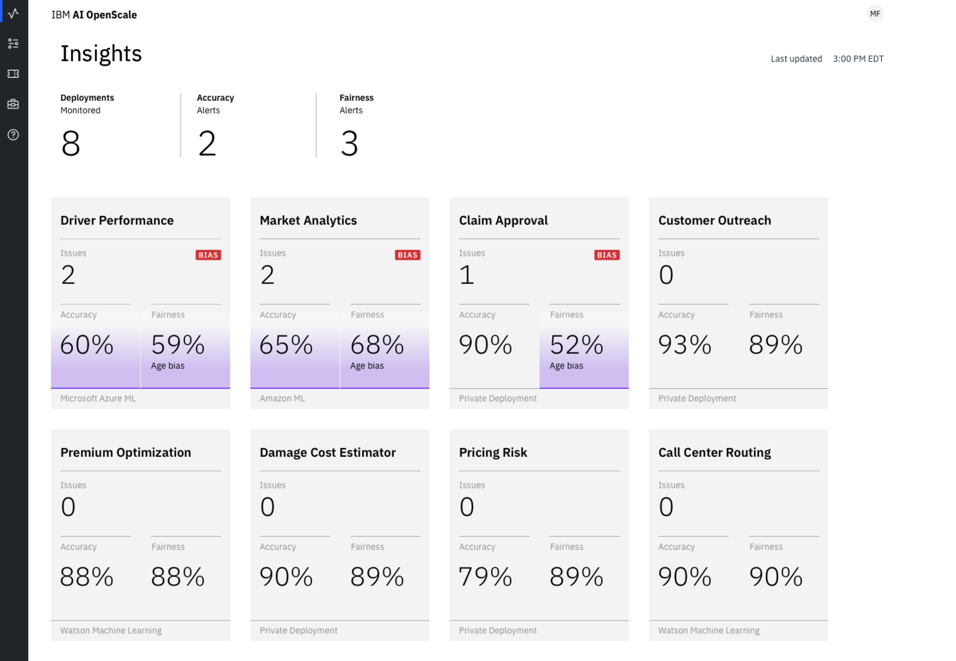
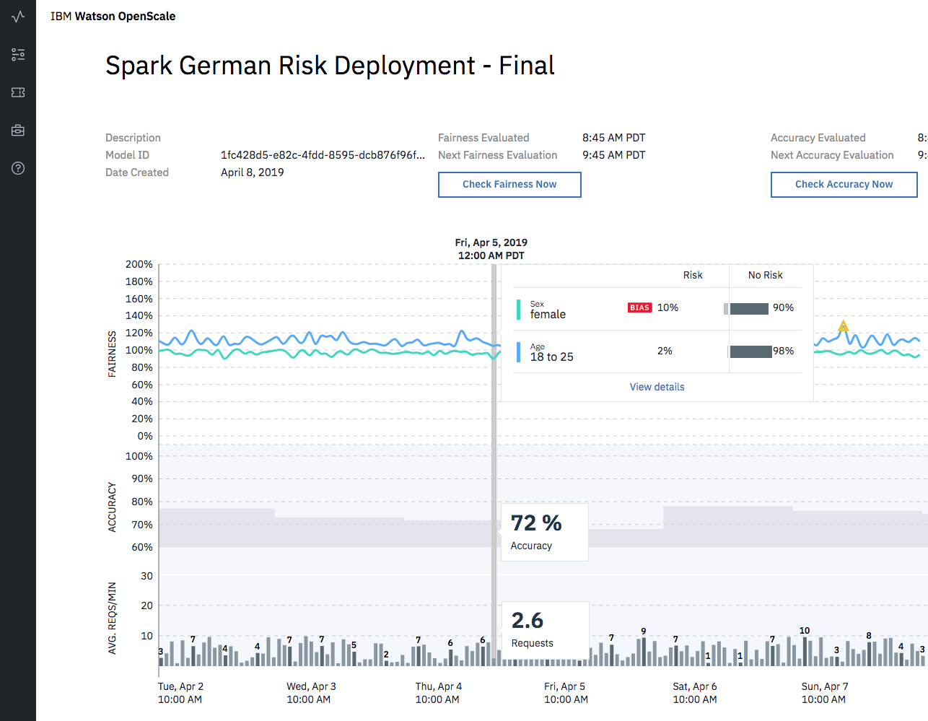
Operations dashboard
Description:
Monitor deployed models in a single dashboard that can be filtered by deployment making it easy to manage AI in apps
Value:
Configure alerts or actions to be triggered when KPIs exceed threshold, ensuring model quality for improve business outcomes
Measure model accuracy as it pertains to it’s ability to deliver outcomes more accurate than knowledge workers
Provides “continuous evolution” for your models

Slide 77
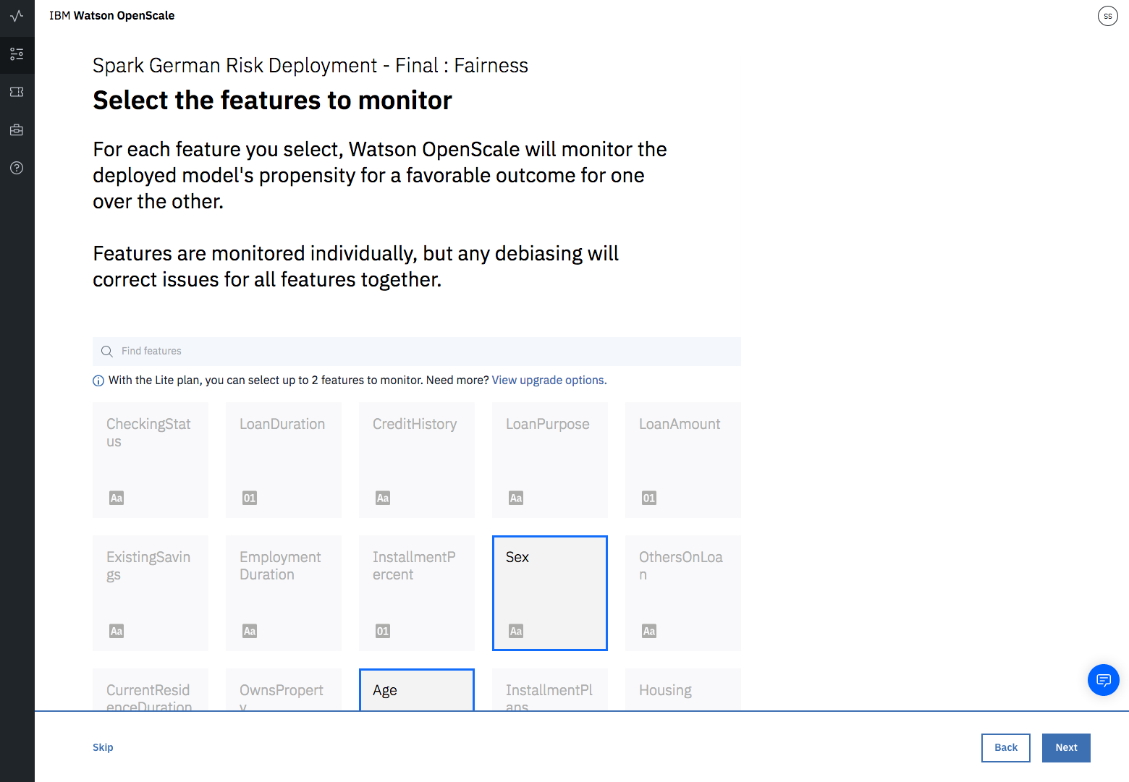
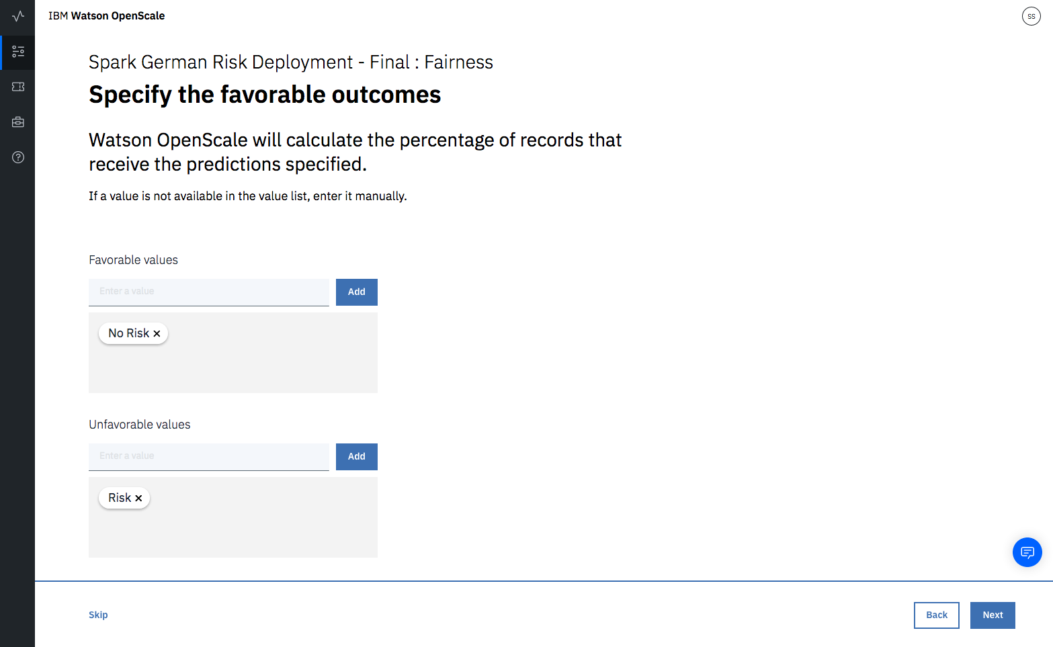
Model Fairness
Description:
Production Models need to make fair decisions and can not be biased in their recommendations
How it works:
Outcomes are selected as “favorable or unfavorable”
“Favored Populations” and “protected populations” are selected where majority and minority groups are found
A score is calculated based on the probability of favorable outcome for minority vs. probability of favorable outcome for majority

Slide 78
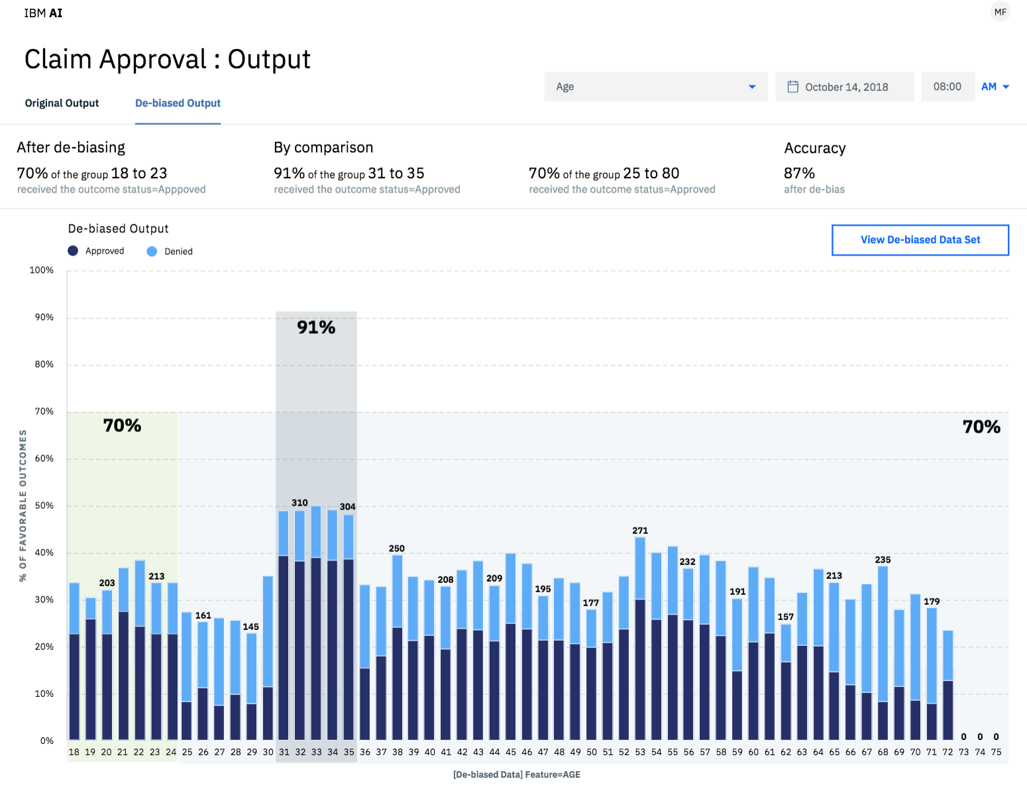
Bias Mitigation
Description:
Fairness is enforced with automatic bias mitigation.
How it works:
Calculated on an hourly basis (over a sliding window defined by the user)
Optimizations identify the right subset of data to perturb (rather than perturbing all the data)
Perturbed data is sent to the deployed model to determine effect of perturbations
An internal bias detection model (logistic regression) is built using perturbed data that classifies whether new prediction will be biased or not
Users receive both the original prediction plus the internal model’s classification of whether the monitored model’s prediction is biased or not

Slide 79
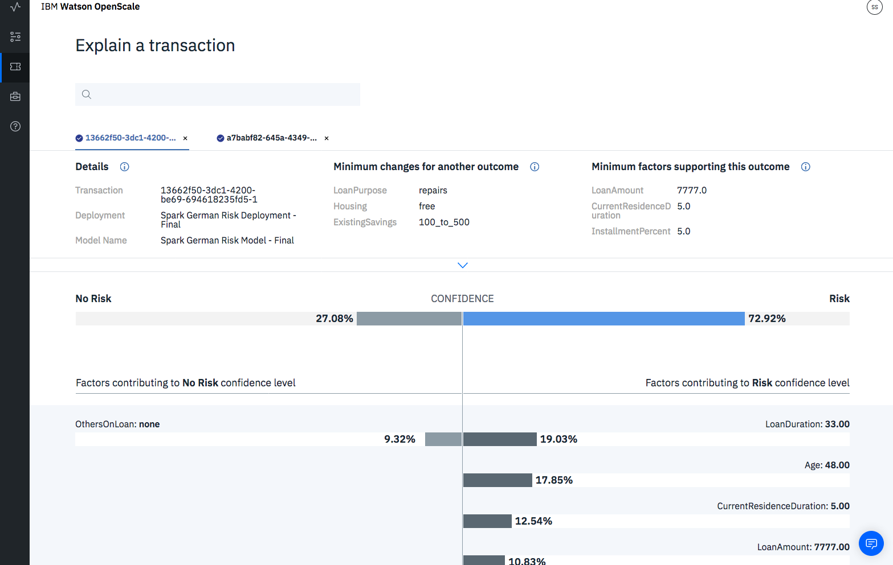
Explainability
Description:
Allows you to understand which feature values of a model that are most influencing a prediction for a specific transaction
Example:
A loan is not approved by a model prediction - explainability will tell you why
How it works:
Perturbation analysis on thousands of variations
Risk model is created for two variations:
LIME (local) Explanation: set of features which played a positive or negative role in the prediction - also identifies the feature weights which helps to identify the most or least important features
Contrastive Explanation: Explains the behavior of the model in the vicinity of the data point whose explanation is being generated – assumption: the most common value is the least interesting from an explanation point of view

Slide 80
Lab 7: Watson OpenScale
Introduction:
IBM Watson OpenScale is an open platform that helps remove barriers to enterprise-scale AI. In this lab you will configure Watson OpenScale to monitor quality, fairness,and drift and to provide the factors that explain a deployed model’s classification.
Objectives:
Upon completing the lab, you will
Import and Deploy a machine learning model
Provision a Watson OpenScale service
Configure Watson OpenScale for Payload Logging, Quality, Fairness, and Drift.
Submit Feedback and View Quality Metrics
Score Data and View Fairness Metrics
Explain a Transaction.

Slide 81
Watson Studio supports the Data Science Lifecycle
Build, train, deploy, and monitor at scale ML/DL workflows to infuse AI into the enterprise to drive innovation.
Lab-2
Connect to Data
Find Governed Data
Save and Deploy
Build Model
Prepare Data
Monitor and Manage
Lab-3
Lab-1
Lab-1
Lab-2
Lab-4
Lab-5
Lab-6
Create Project
Research Topics
Lab-4
Lab-5
Lab-6
Application
Lab-7
Lab-6
Lab-4, Lab-5, Lab-6
Notes:
Position these offerings in how they support the Data Science Project Lifecycle
Start with Creating a Project. The project is a core component of the IBM Data Science Platforms. It is a place where you can organize your resources to achieve a particular data analytics goal.
Research topics – may want to read an article about a technique. Go through a tutorial. Or start with an existing notebook.
Find data that is needed for your analysis.
Connect to data – or access the data
Data Understanding or Data Exploration and Preparation. -

